Slide 1
Tariffs & their Impacts on Recycling
Robin Wiener, ReMA President
RCon by SWANA 2025 (Columbus,OH)
November 13, 2025
Notes:
[20 seconds]
PPT based on being asked to speak about “recycling metals trade around the world, and what's the next step for recycled metals.”
I’m going to provide a high-level update on trends in the economy and markets that impact supply and demand for recycled materials.
This past year has been about navigating complex market conditions where trade policies and economic forces create vastly different outcomes across material streams, supply chains, and regionally.
Let me walk you through what's driving some of these dynamics.

Slide 2
Overview
ReMA and the U.S. recycled materials industry
Navigating Tariffs & challenging market conditions
Other Advocacy & Policy Issues

Slide 3
Who We Are:
ReMA & the Recycled Materials Industry
Notes:
Before I conclude, I want to invite everyone to Rema's upcoming convention - scheduled for May 12th through 15, of 2025 in San diego, CA.
With 7,000 recycling professional expected from around the world and a sold out exhibit hall, we expect for ReMA2025 to be the largest gathering of the industry anywhere in the world.
I sincerely hope that all of you will join us.
And to that CMRA for our friendship over the years, we would like to offer all CMRA members a discount to the Show
Codes are seen on this slide and can be used when you register at ReMA2025.org. Alos, once you register you will have the opportunity to get an automatically generated Visa invitation letter toe as your travel to the United States.

Slide 4

ISRI is now ReMA
The Recycled Materials Association (ReMA) represents more than 1,700 companies in the U.S. and 40 countries around the globe.
Based in Washington, D.C., ReMA promotes safe, economically sustainable and environmentally responsible recycling through networking, advocacy and education.
Notes:
I’m Robin Wiener, the president of the Recycled Materials Association, you may have previously known us as ISRI. ReMA represents over 1,700 recyclers in the U.S. and around the world.

Slide 5
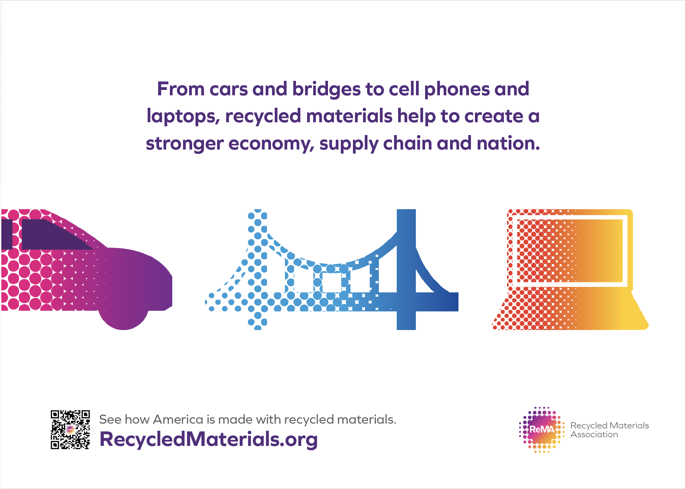

Slide 6
Snapshot: U.S. Recycled Materials Industry
Volume of Recycled Materials Processed in U.S. (2024)
Type of Recycled Material | Million Metric Tons and %
Iron and Steel | 65.0
Nonferrous
Aluminum | 5.7
Copper | 1.8
Lead | 1.0
Zinc | 0.1
Recovered Paper and Fiber | 41.7
Post-Consumer Plastic | 2.3
Electronics | 5.9
Other (Includes Tires & Rubber, Textiles, Glass, etc.) | 11.1
TOTAL | 134.9
U.S. Recycled Materials Exports | 31.6
Export Share | 23%
Represents –
$170 billion in economic impact
600,000 jobs (direct + supplier + induced)
$18.7 billion generated in tax revenues
$11.5 billion in federal taxes
$7.2 billion in state/local taxes
Source: U.S. Geological Survey; U.S. Census Bureau; U.S. International Trade Commission; American Forest & Paper Association; Stina, Inc.; U.S. Tire Manufacturers Association, American Iron and Steel Association, and ReMA analysis.

Slide 7
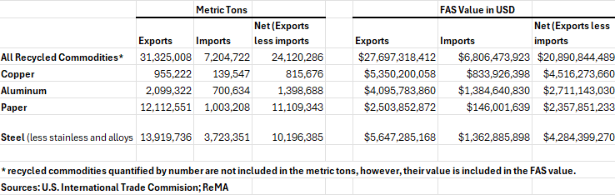
Recycling is driven by demand … and demand is global
In any given year, between 25 - 30% of all recycled materials processed within the United States are sold into the export markets to industrial consumers in more than 100 countries

Slide 8

Importance of Global Market Access
ReMA’s highest priority is ensuring continued market access globally for recycled materials & preserving our trade relationships
The industry is global and requires global market access
The health & success of the industry is dependent upon access to the markets, as the U.S. generates a surplus of recycled materials each year
Export markets keep the industry strong and resilient, and allows for greater domestic investment
Notes:
Updated Nov 4, 2025
The US job market has shown a slowdown in recent months, with August 2025 adding just 22,000 jobs
The US annual inflation rate was 3.0% in September, a slight increase from 2.9% in August and 2.7% in July and June. The 3.0% rate for September is the highest since January.
FOMC lowered the target range for the federal funds rate to 3.75%-4.00% at its October 29, 2025 meeting, citing a shift in risks toward the downside for employment.

Slide 9

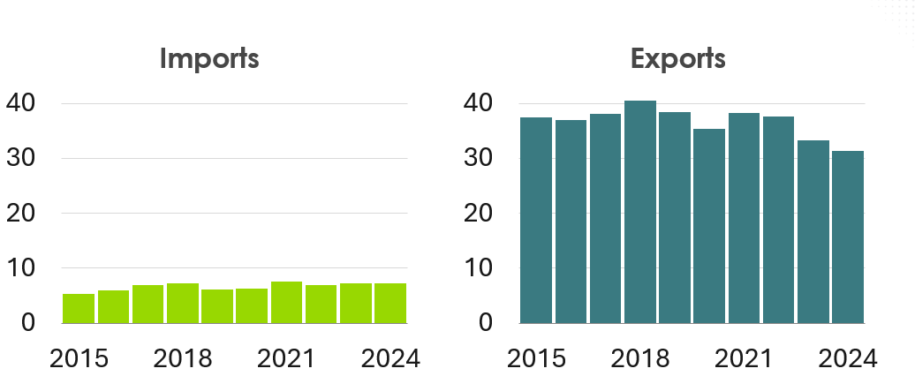
U.S. Trade of Recycled Materials
Million Metric Tons (MMT)
Source: U.S. Census, ReMA Analysis

Slide 10
U.S. Imports of Recycled Materials with North America and Rest of World
THOUSANDS
89%
of volume of U.S. recycled materials imports come from our partners in North America
Million Metric Tons
Source: U.S. Census, ReMA Analysis

Slide 11
2024 U.S. Recycled Materials Exports:
Top 10 Destinations
RANKED BY TONNAGE | MMT |  | RANKED BY VALUE ($) | BILLIONS $
Turkey | 4.4 |  | Canada | 6.2
Mexico | 4.3 |  | China | 3.1
India | 4.3 |  | India | 2.3
Thailand | 2.8 |  | Mexico | 2.1
Malaysia | 2.6 |  | Malaysia | 2.1
Canada | 2.1 |  | Thailand | 1.8
Bangladesh | 1.9 |  | Turkey | 1.7
Vietnam | 1.8 |  | Italy | 1.0
Taiwan | 1.7 |  | South Korea | 1.0
South Korea | 1.0 |  | Germany | 0.7
All others | 4.8 |  | All others | 6.1
TOTAL | 31.6 |  | TOTAL | 28.1
$28
BILLION
Total U.S. Recycled Materials Exports
Source: U.S. Census, ReMA analysis

Slide 12
THOUSANDS
U.S. Exports of All Recycled Materials to WORLD
1989-2024
Millions metric tons
2007 – 2012
274 million mt
2013 – 2018:
236 million mt
2019 – 2024:
214 million mt
2001 – 2006:
156 million mt
1989 – 1994:
111 million mt
1995 – 2000:
99 million mt
Source: U.S. Census, ReMA Analysis

Slide 13
Navigating Tariffs & Challenging Market Conditions
Notes:
Before I conclude, I want to invite everyone to Rema's upcoming convention - scheduled for May 12th through 15, of 2025 in San diego, CA.
With 7,000 recycling professional expected from around the world and a sold out exhibit hall, we expect for ReMA2025 to be the largest gathering of the industry anywhere in the world.
I sincerely hope that all of you will join us.
And to that CMRA for our friendship over the years, we would like to offer all CMRA members a discount to the Show
Codes are seen on this slide and can be used when you register at ReMA2025.org. Alos, once you register you will have the opportunity to get an automatically generated Visa invitation letter toe as your travel to the United States.

Slide 14
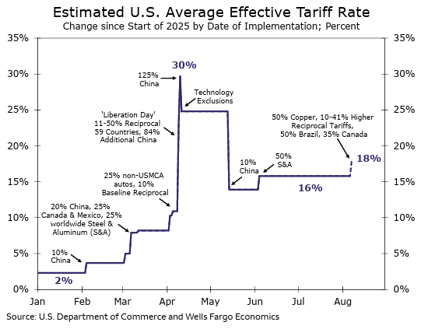
Navigating Trade Disruptions in Recycled Materials
The Challenge
Tariffs much higher, uncertainty, front-loading
Key materials affected: aluminum, steel, copper
Equipment impacted as well
Our Industry’s Strengths
Diverse domestic manufacturing base
Growing U.S. demand for recycled materials
Flexible supply chains adapt to new markets
Innovation and technology advances
How We’re Adapting
Maintain, Diversify export markets
Strengthen processing capacity
Increase recycling and recyclability
Building resilient regional partnerships
Trade disruptions mean we need stronger domestic recycling markets

Slide 15
Presidential Authority to Impose Tariffs
U.S. Constitution gives Congress power to (1) regulate foreign commerce, (2) impose import tariffs and (3) raise revenue.
Congress has delegated significant authority to impose tariffs to the Executive Branch through multiple laws:
Antidumping and countervailing duty laws to address unfair trade
Section 201 – safeguard action
Section 232 – national security
Section 301 – unfair foreign trade practices
International Emergency Economic Powers Act (IEEPA)

Slide 16
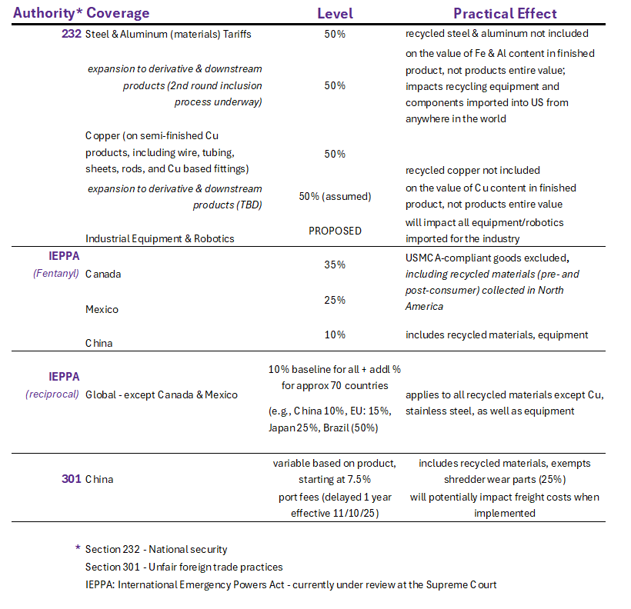
Specific Tariffs Impacts

Slide 17
Slowing Global Growth
Economic Growth: Real GDP % growth, 2024-2026f
Source: EY Parthenon, TD Bank, International Monetary Fund, Wells Fargo Economics. October 2025.

Slide 18
Industrial Sector Weak in the U.S and Globally
50
Manufacturing PMI below 50 = weakening demand for recycled materials
Source: Institute for Supply Management (ISM), J.P.Morgan, Updated November 2025
Notes:
U.S. Manufacturing PMI: <50 (contraction) for 8+ mos; exceptional performance post-Covid has faded
China PMI: >50 (expansion) for 3 mos but, not above 50 by much. China’s PMI has been hovering around the 50-line (no growth) for some time
Global PMI: >50 (expansion) for 3 mos but, not above 50 by much. Global manufacturing has generally lacked momentum since mid-2022 (most recent reading is 50.8)

Slide 19
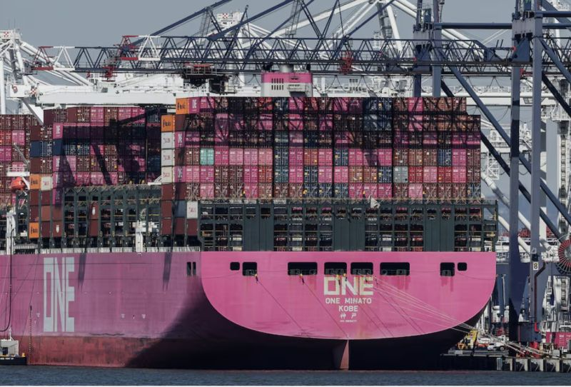
Other Threats to Global Market Access
USMCA Review
ReMA priorities include:
Continued qualification of pre- and post-consumer recycled materials collected in North America for purposes of origination
Trade facilitation (improvement of physical infrastructure (land & seaports), streamlining customs paperwork & clearance; greater automation
Standards & specifications (push for regulatory coherence across North America & use of ReMA’s ISRI Specs)
Basel Convention
Classification of certain non-ferrous materials (Zorba, ICW & motors) as “E-Waste” under Basel and thus illegal for importation
New Chinese Import Restrictions on Recycled Dry-Milled Pulp
Governments need help differentiating shipments of recycled materials from shipments of waste:
Specifications critical
Training of customs agents in other countries
ReMA working on a possible “export certification”
Standards:
Chinese government attempting to create new global standard for recycled steel through ISO

Slide 20
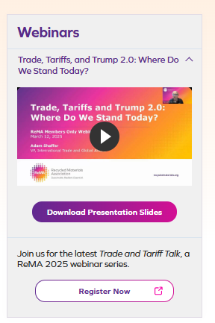
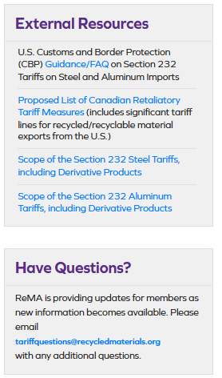
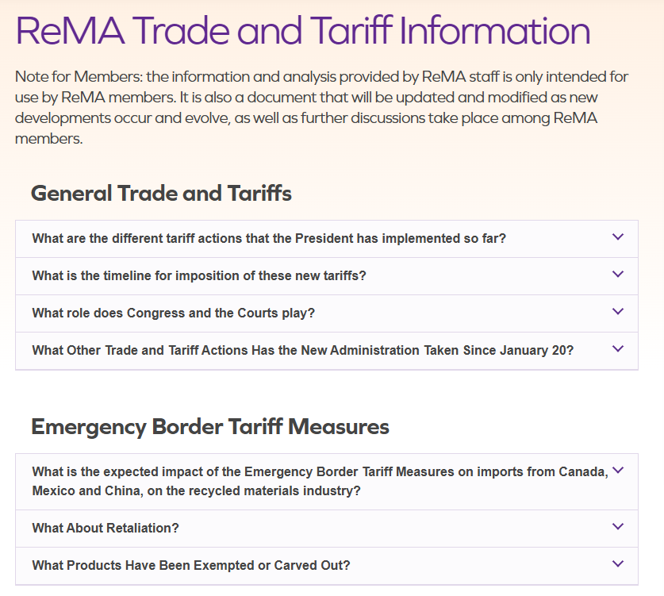
Member Resources
www.recycledmaterials.org/trade

Slide 21
Other Advocacy & Policy Issues
Notes:
Before I conclude, I want to invite everyone to Rema's upcoming convention - scheduled for May 12th through 15, of 2025 in San diego, CA.
With 7,000 recycling professional expected from around the world and a sold out exhibit hall, we expect for ReMA2025 to be the largest gathering of the industry anywhere in the world.
I sincerely hope that all of you will join us.
And to that CMRA for our friendship over the years, we would like to offer all CMRA members a discount to the Show
Codes are seen on this slide and can be used when you register at ReMA2025.org. Alos, once you register you will have the opportunity to get an automatically generated Visa invitation letter toe as your travel to the United States.

Slide 22

ReMA’s Advocacy Agenda
Organized around 5 key objectives:
Championing Environmental Stewardship within Reasonable Regulatory Frameworks
Maintaining Market Access, Development, and Sustained Economic Growth
Ensuring A Safe and Circular Environment in the Era of Decarbonization and Increasing Electrification
Promoting Safe and Responsible Recycling Operations
Shaping the Future by Advancing Education, Workforce Development, and Responsible Governance
https://www.recycledmaterials.org/advocacy-compliance/

Slide 23
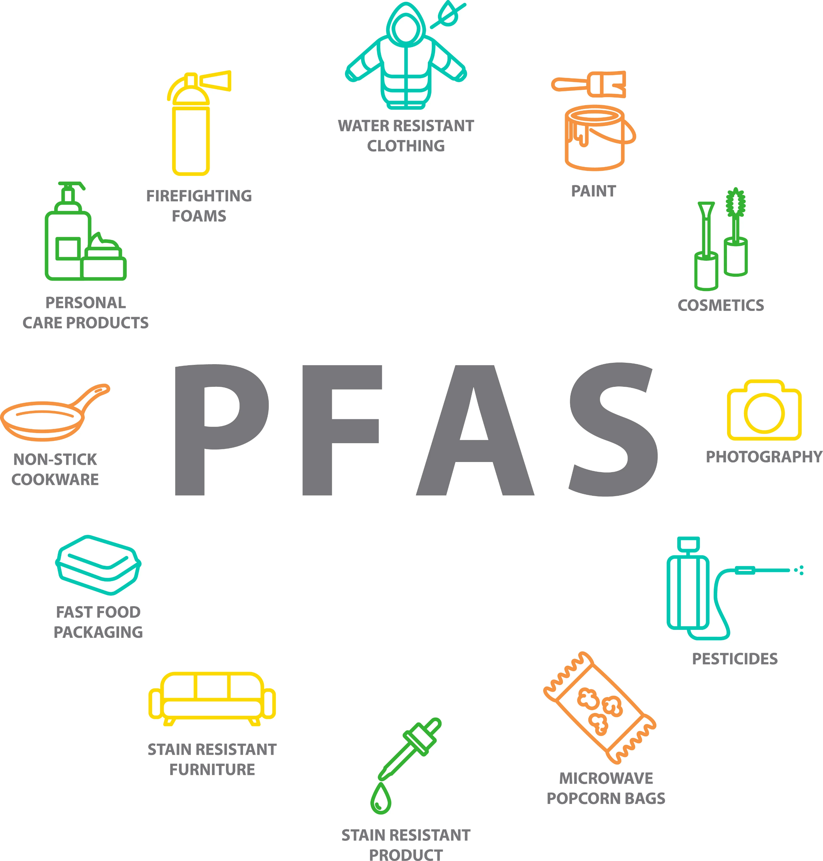
Challenge: PFAS
PFAS is in almost every consumer product and durable goods, and these goods work there way into the recycling stream which creates risks and liabilities for the industry
Need for passive liability protections
Policy, data, legal and technology issue

Slide 24

Challenge: Role of Recycled Materials in Supply Chain
Need to encourage resilient supply chains & confirm that recycled materials are essential
Industry was able to continue working during COVID-19 due to designation as essential by DHS
Changes at DHS and workflow have created confusion
Need reconfirmation more clearly identifying recycling as an essential industry to protect the US economy from supply chain disruptions and uninterrupted manufacturing operations during times of crises and unforeseen national emergencies

Slide 25
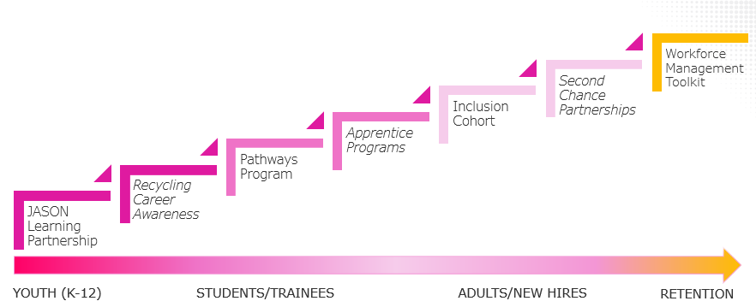
Challenge: Workforce Recruitment & Retention

Slide 26
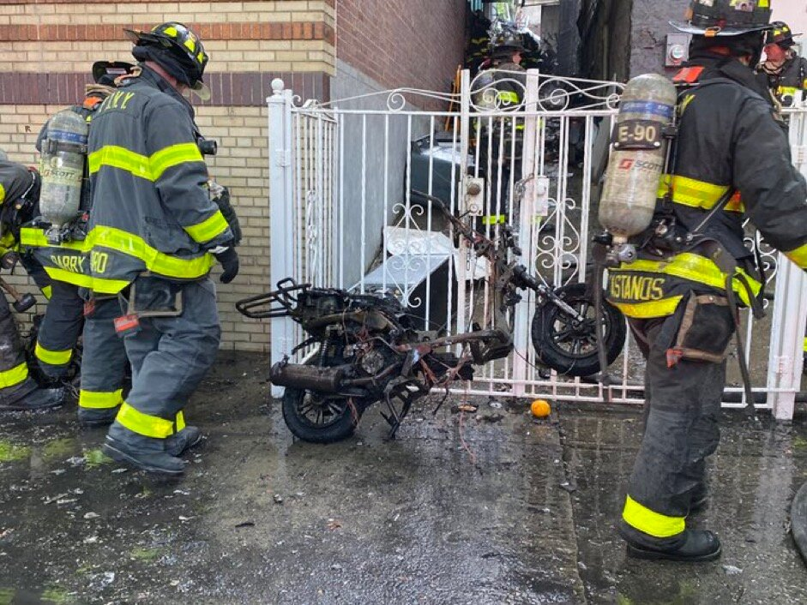
Challenge: Batteries
Batteries are an unprecedented safety risk to the recycling industry when placed in the wrong streams.
AND
Batteries contain critical, strategically valuable materials with recyclers ready to process them in the United States.
3 Prong Approach at ReMA:
Awareness (internal & external)
Policy
Technology

Slide 27


Scan Here To
REGISTER NOW
Notes:
Join us at the largest gathering of recycled materials industry professionals in the world.
April 13-16, 2026, in Las Vegas, NV

Slide 28
Thank you and Happy America Recycles Day 2025!
Robin K. Wiener
President
rwiener@recycledmaterials.org
202-662-8512

